Slide 1
Introduction to Data Science
Unit 3

Slide 2
Central Limit Theorem(CLT)

Slide 3
Central Limit Theorem
Let X1, X2 .. Xn be a simple random sample from a population with mean μ and standard deviation σ .
Let X_bar deonte the Sample mean
Let S_{n} denote sum of the sample observations
Then if n is sufficiently large then,
X_bar ~ N( μ , σ ²/n ) approx. &
S_{n} ~ N( n μ , n σ ² ) approx.

Slide 4
Problem 1
A simple random sample of 100 men is chosen from a population with mean height 70 in. & standard deviation 2.5 in.
What is the probability that the average height of the sample men is greater than 69.5 in?

Slide 5
Problem 1 - Solution
n = 100
Let X denote the average height of the men. mean of sample = μ_{x} = 70
standard deviation of sample = s = 2.5 Using CLT, we can say,
X_bar ~ N( μ , σ ²/n ) approx.
Since n is large, we replace μ with sample mean μ_{x} and population SD σ with sample SD s.
X_bar ~ N( μ _{x} , s²/n ) approx.
P(X_bar > 69.5) = ?
We can standardize X_bar as z = (69.5 – 70)/(2.5/sqrt(100)) = -2 P(Z > -2) = .9772

Slide 6
Problem 2
The manufacture of a certain part requires two different machine operations.
The time on machine 1 has mean 0.5 hours and standard deviation 0.4 hours.
The time on machine 2 has mean 0.6 hours and standard deviation 0.5 hours.
The times needed on the machines are indpendent. Suppose 100 parts are manufactured.
What is the probability that the total time used by machine 1 is greater than 55 hours?
What is the probability that the total time used by machine 2 is less than 55 hours?
What is the probability that the total time used by both the machines together is greater than 115 hours.
What is the probability that the total time used by machine 1 is greater than the total time used by machine 2?
●
●
●
●

Slide 7
Problem 2 - Solution
1) What is the probability that the total time used by machine 1 is greater than 55 hours? Let X represent the time on machine 1.
S_{x} ~ N(100 * 0.5 , 100 * 0.4²) P( S_{x} > 55) = ?
P( Z > (55 – 50)/ 4) = P(Z > 1.25) = 0.1056

Slide 8
Problem 2 - Solution
2) What is the probability that the total time used by machine 2 is less than 55 hours?
Let Y reprsent time on machine 2. S_{y} ~ N(100 * 0.6 , 100 * 0.5²)
P(S_{y} < 55) = ?
P( Z < (55 – 60)/ 5) = P(Z < -1) = 0.1587

Slide 9
Problem 2 - Solution
3) What is the probability that the total time used by both the machines together is greater than 115 hours.
Let T reprsent time on both machine 1 and 2.
S_{T} ~ N(( 100 * 0.5 + 100 * 0.6), (100 * 0.4² +100 * 0.5²))
S_{T} ~ N(110, 41)
P(S_{T} > 115) = ?
P( Z > (115 – 110)/ 6.40) = P(Z > 0.78) = 0.2177

Slide 10
Problem 2 - Solution
4) What is the probability that the total time used by machine 1 is greater than the total time used by machine 2?
Let D reprsent difference in time of machine 1 and 2. S_{D} ~ N(( 100 * 0.5 - 100 * 0.6), (100 * 0.4² +100 * 0.5²)) S_{D} ~ N(-10, 41)
P(S_{D} > 0) = ?
P( Z > (0 – (-10))/ 6.40) = P(Z > 1.56) = 0.0594

Slide 11
Point Estimate

Slide 12
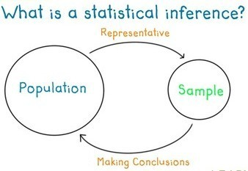
Statistics are used to estimate the value of the parameters. For example:
●
●
Sample Mean used to estimate Pop mean
Sample proportion used to estimate Pop proportion
These estimates are called Point estimates as Its a single value.
●

Slide 13
Example
Point estimate:
X ~ Bin(n, p) and X is observed as 7, where n =20 then,
p_hat = 7/ 20
(point estimate)
p_hat = X/n
(point estimator – no
particular value of X is specified)

Slide 14
We address 2 Questions in this section
How to determine goodness of point estimator?
What methods can be used to construct good point estimators?

Slide 15
Measuring goodness of an Estimator
An estimator must be both accurate(measured by bias) and precise(measured by uncertainity).
MSE – Mean squared Error – quantity used to evaluate overall goodness of an estimator.
●
●
MSE = Bias² + Uncertainity²

Slide 16
Problem 1
Let X ~ Bin(n,p) where p is unknown. Find MSE of p_hat = X / n.

Slide 17
Problem 2
Let X1 and X2 be independent, each with unknown mean µ and variance = 1.
Let µ_hat = (X1 + X2) / 2. Find bias, variance, and MSE of µ_hat.
Let µ₂_hat = (X1 + X2) / 4. Find bias, variance, and MSE of µ₂_hat.
For what values of µ does µ₂_hat have smaller MSE
than µ_hat?

Slide 18
Method to construct good Estimator
Method of Maximum Likelihood is regarded as the best method to point estimation.
Likelihood function is the probability of obtaining observed value.
If single observation is made, Likelihood fuction is just the probability of obtaining that value. (There will be no product involved)
●
MLE (maximum likelihood estimator) – is that value of the estimator which when substituted in place of the parameter, maximizes the Likelihood function.

Slide 19
MLE – when there's just one parameter to estimate
General method:
Step I : Write down the likelihood function.
Step II : Take natural log of likelihood function.
(reason: the quantity that maximizes log of a function is always the same quantity that maximizes the function itself)
Step III : Differentiate log-likelihood fuction w.r.t parameter being estimated.
StepIV : Set the derivative equal to 0 to get MLE.
●

Slide 20
MLE – when there's more than one parameter to estimate
General method:
Step I : Write down the likelihood function.
Step II : Take natural log of likelihood function.
(reason: the quantity that maximizes log of a function is always the same quantity that maximizes the function itself)
Step III : Partially Differentiate log-likelihood fuction
w.r.t each parameter being estimated.
StepIV : Set the derivative in each case equal to 0 to get MLE of required parameter.
●

Slide 21
Problems
1) X ~ Bin(20, p) where X is observed as 7. Find MLE of p.
[Hence find MLE of p if X ~ (n,p)]
2) Suppose no of claims in a month from a certain portfolio of policies has a Poisson distribution with mean µ.
The no of claims observed in one particular month is 8. Find MLE of λ.
In one month 8 claims were incurred and in next month 10 claims were incurred. Find MLE of λ.
●
●
[Hence find MLE of λ if X ~ Poisson(λ)]

Slide 22
Problems
Find MLE of p if X ~ Geom(p).
Find MLE of λ of if X ~ Exp( λ).
Let X1, X2, Xn be a random sample from N(µ, 1) population. Find MLE of µ.
Let X1, X2, Xn be a random sample from N(0, σ²) population. Find MLE of σ.
6) Let X1, X2, Xn be a random sample from N(µ, σ²) population. Find MLE of µ and σ.

Slide 23
Point Estimate

Slide 24
Statistics are used to estimate the value of the parameters. For example:
●
●
Sample Mean used to estimate Pop mean
Sample proportion used to estimate Pop proportion
These estimates are called Point estimates as Its a single value.
●

Slide 25
Example
Point estimate:
X ~ Bin(n, p) and X is observed as 7, where n =20 then,
p_hat = 7/ 20
(point estimate)
p_hat = X/n
(point estimator – no
particular value of X is specified)

Slide 26
CONFIDENCE INTERVALS

Slide 27
Confidence Intervals
Its an interval estimate for a population parameter.
Based on sample data and provides a range of plausible values for a parameter.
Confidence Interval differs from sample to sample (taken from same population).
Associated with each Confidence Interval is a Confidence level.
For example: we may be 95% confident that µ (population parameter) lies in the interval (-0.2, 3.1). Here, being 95% is the confidence level associated with the Confidence Interval (-0.2, 3.1).
●
●
●
●
●

Slide 28
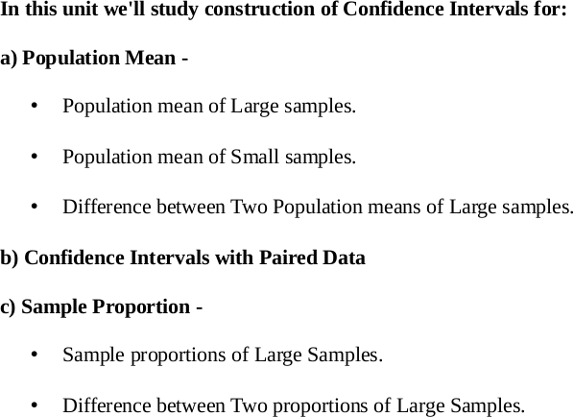

Slide 29
Construction of Confidence Intervals for Population Mean of Large Samples:

Slide 30
Construction of Confidence Intervals for Population Mean of Large Samples:
point estimate ± Margin of error
Confidence Interval for μ will be of the form:
X_bar ± Margin of error

Slide 31
Construction of Confidence Intervals for Population Mean of Large Samples:
A (1 – α) 100% Confidence Interval for μ is given by
X_bar ± z_{α/2} (σ /√n)
where, the quantity z_{α/2} (σ /√n) is the Margin of error.
Note: (σ /√n) is the standard deviation of Sampling distribution of sample mean (X_bar).

Slide 32
Problem 1
Problem 1 : Find the value of zα/2 to use to construct a confidence interval with level:
a) 95%
b) 98%
c) 99%
d) 80%

Slide 33
Problem 1 : Solution
a)95% : X_bar ± 1.96 (σ /√n)
b) 98% : X_bar ± 2.33 (σ /√n)
c) 99% : X_bar ± 2.57 (σ /√n)
or
X_bar ± 2.58 (σ /√n)
d) 80% : X_bar ± 1.28 (σ /√n)

Slide 34
Problem 2
Find the levels of confidence intervals that have the following values of z_{α/2} :
a) z_{α/2} = 2.17 b) z_{α/2} = 3.28

Slide 35
Problem 2 : Solution
a) z_{α/2} = 2.17
P( -z0.015
< Z < z_{0.015} ) = 1 –0.03
Hence the confidence level is 97%
b) z_{α/2} = 3.28
P( -z0.0005
< Z < z_{0.0005} ) = 1 –0.001
Hence the confidence level is 99.9%

Slide 36
Problem 3
In a sample of 100 wires the average breaking strength is 50kN, with a satandard deviation of 2kN.
Find 68% confidence interval for the mean breaking strength of this type of wire.
Find 80% confidence interval for the mean breaking strength of this type of wire.
Find 90% confidence interval for the mean breaking strength of this type of wire.
Find 95% confidence interval for the mean breaking strength of this type of wire.
Find 99% confidence interval for the mean breaking strength of this type of wire.

Slide 37
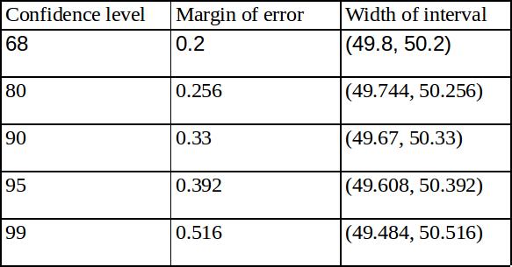
Problem 3 : Solution
Trade of between Confidence level we pick and the width of the interval. This means higher the confidence level, wider the interval.

Slide 38
Problem 3 - Continued
In a sample of 100 wires the average breaking strength is 50kN, with a satandard deviation of 2kN.
An engineer claims that the mean breaking strength is between 49.7kN and 50.3kN. With what level of confidence can this statement be made?
How many wires must be sampled so that a 95% confidence interval specifies the mean breaking strength to within 0.3 kN?
How many wires must be sampled so that a 99% confidence interval specifies the mean breaking strength to within 0.3 kN?

Slide 39
Problem 3 : Solution
An engineer claims that the mean breaking strength is between 49.7kN and 50.3kN. With what level of confidence can this statement be made?
confidence interval (49.7, 50.3) corresponds to 86.64% confidence level.
How many wires must be sampled so that a 95% confidence interval specifies the mean breaking strength to within 0.3 kN?
171 wires must be sampled so that a 95% confidence interval specifies the mean breaking strength to within 0.3 kN.
h) How many wires must be sampled so that a 99% confidence interval specifies the mean breaking strength to within 0.3 kN?
Hence 296 wires must be sampled so that a 99% confidence interval specifies the mean breaking strength to within 0.3 kN.

Slide 40
Problem 4
An investigator computes 95% confidence interval for a population mean on the basis of a sample of size 70. If she wishes to compute a 95% confidence interval that is half as wide, how large a sample does she need?

Slide 41
Problem 4 : Solution
Sample size should be 280.

Slide 42
Problem 5
A 95% confidence interval for a population mean is computed from a sample of size 400. Another 95% confidence interval will be computed from a sample of size 100, drawn from the same population. Choose the best answer to fill in the blank; the interval from the sample of size 400 will be approximately
as the interval from the sample of size 100.
a) 1/8th as wide width
e) twice as wide wide
b) 1/4th as wide c) 1/2 as wide d) same
f) four times as wide h) eight times as

Slide 43
Problem 5 - Solution
The ratio of the widths is equal to the ratio of the standard deviations of the sample mean,
1.96 (σ /20) : 1.96 (σ /10) => (σ /20) : (σ /10) => 10 :
20 => 1:2
=>the interval from the sample of size 400 will be approximately half(1/2) as wide as the interval from the sample of size 100. [option c]

Slide 44
Interpreting Confidence Intervals

Slide 45
Assumptions made in interpreting a CI of a mean:
To interpret the confidence interval of the mean, you must assume that:
All the values were independently and randomly sampled from a population whose values are distributed according to a Gaussian(Normal) distribution.

Slide 46
Probability vs Confidence
It is correct to say that there is a 95% chance that the confidence interval you calculated contains the true population mean.
It is not quite correct to say that there is a 95% chance that the population mean lies within the interval.
The population mean has one value.
In contrast, the confidence interval you compute depends on the data you happened to collect.

Slide 47
Meaning and Interpretaion of Confidence Interval:
Were this procedure to be repeated on multiple samples, the calculated confidence interval (which would differ for each sample) would encompass the true population parameter 90% of the time.
Python Demo : Use height-weight csv. Take 100 samples each of sample size 1000.
Compute 95% CI for each sample and observe how many of CI's contain µ

Slide 48
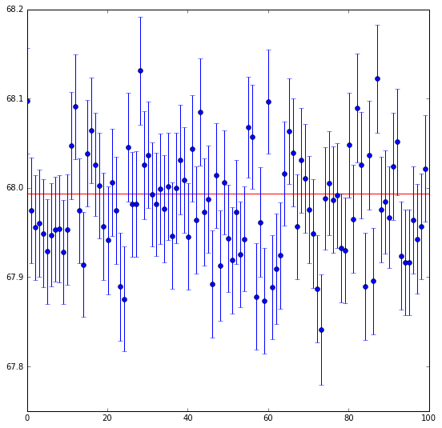
68% Confidence Level

Slide 49
Misinterpretations ofConfidence Intervals
A 95% confidence interval does not mean that for a given realised interval calculated from sample data there is a 95% probability the population parameter lies within the interval, nor that there is a 95% probability that the interval covers the population parameter.
A 95% confidence interval does not mean that 95% of the sample data lie within the interval.
A confidence interval is not a range of plausible values for the sample mean, though it may be understood as an estimate of plausible values for the population parameter.

Slide 50
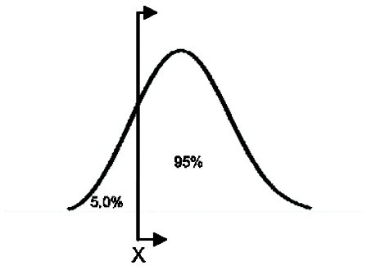
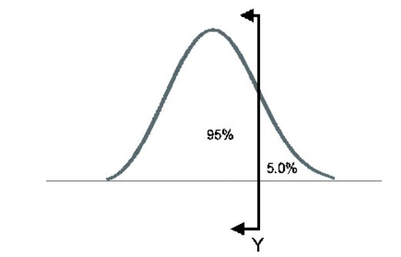
One-sided Confidence Intervals
An upper one-sided bound defines a point that a certain percentage of the population is less than. For example, if X is a 95% upper one-sided bound, this would indicate that 95% of the population is less than X.
A lower one-sided bound defines a point that a specified percentage of the population is greater than.
For example, If X is a 95% lower one-sided bound, this would indicate that 95% of the population is greater than X.

Slide 51
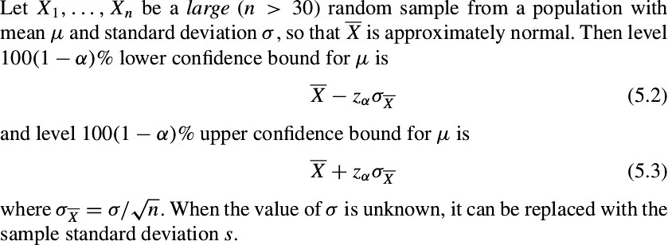

Slide 52
Problem 1
In a sample of 80 ten-penny nails, the average weight was 1.56g and the standard deviation was 0.1g.
Find a 90% upper confidence bound for the mean weight.
Find a 80% lower confidence bound for the mean weight.
Someone says that the mean weight is less than 1.585g. With what level of confidence can this statement be made?

Slide 53
Problem 1 : Solution
90% upper confidence bound for the mean weight.
= 1.5743
Find a 80% lower confidence bound for the mean weight.
= 1.551
Someone says that the mean weight is less than 1.585g. With what level of confidence can this statement be made?
Hence we can make the statement with 98.75% confidence.

Slide 54
Problem 2
One step in the manufacture of a certain metal clamp involves the drilling of four holes. In a sample of 150 clams, the average time needed to complete this step was 72 seconds and the standard deviation was 10 seconds.
An efficiency expert says that the mean time is greater than 70 seconds. With what level of confidence can this statement be made?

Slide 55
Problem 2 : Solution
mean = 72
sigma = 10
n = 150
Mean > 70
That means the lower confidence bound = 70 mean – lower_bound = 72 - 70 = 2
=> - z * (10/sqrt(150)) = 2
=> z = - 2.449 = - 2.45
=> Area to right of -2.45 = Area to the left of 2.45 = 0.9929 Hence we can make the statement with 99.29% confidence.

Slide 56
Factors that affect the Margin of Error
( zα/2 (σ /√n) )

Slide 57
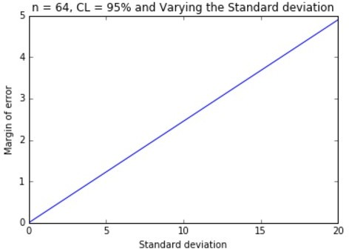

Slide 58
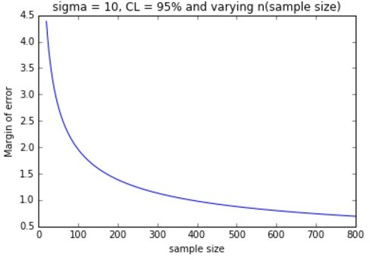

Slide 59
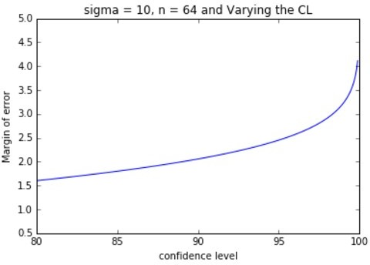

Slide 60
Observations
Margin of error increases linearly with increase in standard deviation(as Sigma is in the numerator) => keeping all other factors constant, doubling the SD doubles the Margin of error.
The greater the Sample size, more information we have and more precisely we'll be able to pin down the value of the parameter of interest and smaller the margin of error. Hence in order to cut the margin of error in half, we would need to quadruple the sample size.
We know, there's a trade off between the confidence level and the width of the interval. Greater the confidence, greater the margin of error. Beyond 95% CL the curve goes up quickly, hence in most practical situations we feel 95% CL provides a good balance between high confidence and reasonable margin of error.

Slide 61
Construction of Confidence Intervals for Population Mean of Small Samples (n < 30)

Slide 62
Introduction
If the sample size is small, standard deviation (s) of the sample may not be close to σ (population standard deviation). Hence X_bar(sample_mean) may not be aproximately normal.
However, if the population from which the sample is drawn is known to be approximately normal (can be confirmed using normal probability plot). It turns out that we can still use the quantity (X_bar - μ ) / ( s /√n), but since s is not necessarily close to σ , the quantity will not have a normal distribution.
Instead it has Student's t distribution with n – 1 degrees of freedom, denoted as t_{n – 1} .

Slide 63
THE t DISTRIBUTION
The t distribution is a theoretical probability distribution.
It is symmetrical, bell-shaped, and similar to the standard normal curve.
It differs from the standard normal curve, however, in that it has an additional parameter, called degrees of freedom, which changes its shape.
df = sample size – 1
Setting the value of df defines a particular member of the family of t distributions.(df > 0 => Sample Size > 1)
●
●
●
●
●

Slide 64
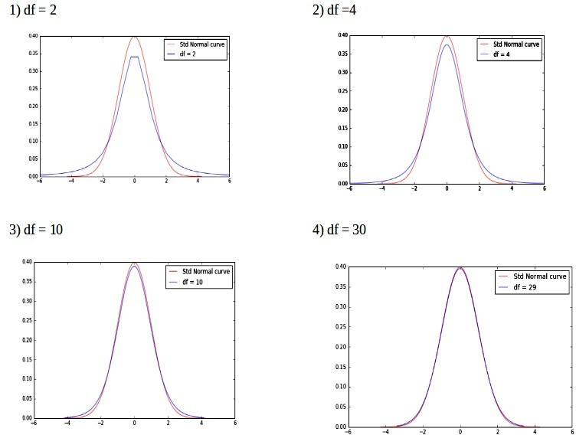
Student's t distribution
Prof. Preet Kanwal

Slide 65
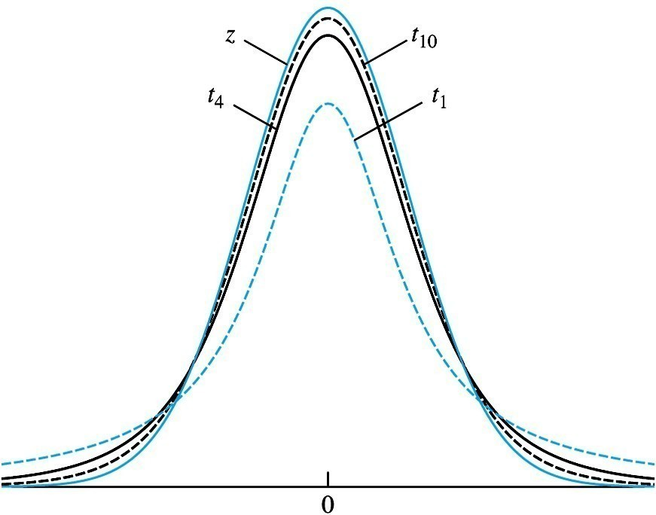
Note that the smaller the df, the flatter the shape of the distribution, resulting in greater area in the tails of the distribution.

Slide 66
RELATIONSHIP TO THE NORMAL CURVE
As the df increase, the t distribution approaches the standard normal distribution (µ=0.0, σ=1.0).
The standard normal curve is a special case of the t distribution when df= infinity.
For practical purposes, the t distribution approaches the standard normal distribution relatively quickly, such that when df=30 the two are almost identical.
●
●

Slide 67
Using t table
We use t table to find probabilites associated with t distribution.
Row headings – denotes degree of freedom
Column headings – denotes the area to the right(probabilities)
The value in particular row and column specifies the t-score where,
P(t > t-tscore) = col_heading

Slide 68
Problem 1
A random sample of size 10 is drawn from a normal distribution with mean 4.
Find P(t >1.833)
Find P(t > 1.5)
2) Find the value of t12 distribution where upper-tail probability is 0.025.

Slide 69
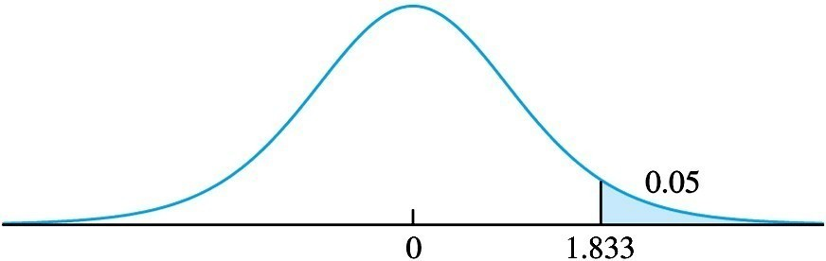
Solution: Problem 1 – Part 1 (a)
a) Find P(t >1.833) df = 9 (row_heading) t-score = 1.833
corresponding col_heading = 0.05
P(t >1.833) = 0.05

Slide 70
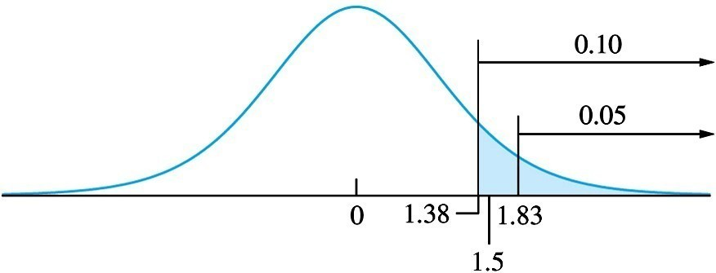
Solution: Problem 1 – Part 1 (b)
b) Find P(t > 1.5)
df = 9 (row_heading)
t-score = 1.5 [does not correspond to any of the values in that row]
but we do have t-scores 1.383, 1.833 corresponding to upper tail probabilties 0.10 and 0.05 respectively. That is,
P(t >1.383) = 0.10 and P(t >1.833) = 0.05
Since 1.383 < 1 .5 < 1.833 => 0.05 < P(t > 1.5) < 0.10

Slide 71
Solution: Problem 1 – Part 2
Problem 2: Find the value of t₁₂ distribution where upper-tail probability is 0.025.
Solution:
row_head = 12
col_head = 0.025
=> t-score = 2.179

Slide 72
Student's t Distribution is Appropriate when
●
●
Sample size is small (n < 30)
Sample comes from a population that is approximately normal. In many cases, we must examine the sample for normality, by constructing a box plot or normal probbaility plot. Should not be used for samples that contain outliers.
●
●

Slide 73
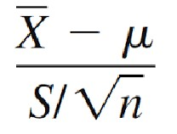
Constructing Confidence Interval for Small Samples using t distribution:
The quantity,
has a t distribution with n – 1 degrees of freedom. We can generate a (1 – α) 100% Confidence Interval
for μ as
s
X ± t
.
n−1,α /2
n

Slide 74
One-Sided CI for Small Samples
We can generate a (1 – a) 100% Upper Confidence bound for μ as:
X_bar + tn -1 , α ∗ s/sqrt(n)
We can generate a (1 – a) 100% Lower Confidence bound for μ as:
X_bar - tn -1 , α ∗ s/sqrt(n)

Slide 75
Problem 2
Find the value of t_{n -1 , α/2} needed to construct a two- sided confidence interval of the given level with the given sample size:
90% with sample size 12
95% with sample size 7

Slide 76
Problem 2 : Solution
90% with sample size 12
df = 11
alpha = 0.10 => alpha/2 = 0.05
=> in t table : row_heading = 11, col_heading = 0.05 => t_{11, 0.05} = 1.796
95% with sample size 7
df = 6
alpha = 0.05 => alpha/2 = 0.025
=> in t table : row_heading = 6, col_heading = 0.025 => t_{6, 0.025} = 2.447

Slide 77
Problem 3
Find the level of two-sided confidence interval that is based on the given value of tn -1 , α/2 and the given sample size:
t = 5.841, sample size = 4
t = 1.746, sample size = 17

Slide 78
Problem 3 : Solution
a) t = 5.841, sample size = 4
df = 3
In t table row_heading = 3 and look for corresponding col_heading where row value = 5.841
=> col_heading = 0.005 = alpha/2 confidence level = 99%
b) t = 1.746, sample size = 17
df = 16
=> alpha = 0.01 =>
In t table row_heading = 16 and look for corresponding col_heading where row value = 1.746
=> col_heading = 0.05 = alpha/2 => alpha = 0.1 => confidence level = 90%

Slide 79
Problem 4
Following represents the measurements of the nominal shear strength (in kN) for a sample of 15 prestressed concrete beams:
580 | 400 | 428 | 825 | 850 | 875 | 920 | 550
575 | 750 | 636 | 360 | 590 | 735 | 950
Is it appropriate to use the Student's t statistic to construct a 99% confidence interval for the mean shear strength?
If so, construct the confidence interval. If not, explain why not.

Slide 80
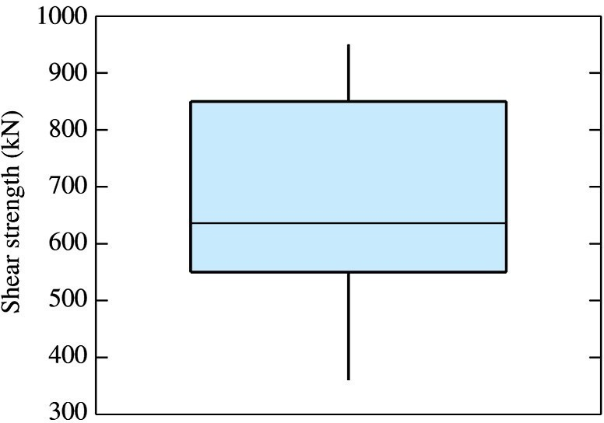
Since there are no outliers in the data set, Student's t statistic can be used to construct 99% CI.

Slide 81
Problem 4 – Solution
Sample mean = X_bar = 668.27
Sample standard deviation = s = 192.089
●
●
tn -1 , α/2 = t15 -1 , 0.005
99% CI :
= 2.977
●
●
668.27 ± 2.977 * 192.089/sqrt(15)
=(520.62, 815.92)

Slide 82
Problem 5
The following are summary statistics for a data set. Would it be appropriate to use the Student's t distribution to construct a confidence interval from these data?

Slide 83
Problem 5 : Solution
There should be no outliers in the data in order for t distribution to be appropriate.
IQR = Q3 – Q1 = 6.136
Lower_ext = Q1 – 1.5(IQR) = Q1 – 9.204 = -7.237
Since, min > Lower_ext => there are no outliers in the negative direction.
Upper_ext = Q3 + 1.5(IQR) = Q3 + 9.204 = 17.307
Since max > Upper_ext => there are outliers in the positive direction.
Hence, t distribution is not appropriate, as the sample does not appear to come from a normal population due to the
presence of an outlier.

Slide 84
Problem 6
The following data presents a confidence interval for a population mean, but some of the numbers are missing. Fill the missing numbers for (a) , (b) and (c).

Slide 85
Problem 6 : Solution
SE of mean = sigma / sqrt(n)
=> sigma = SE of mean * sqrt(n) => sigma = 0.52640 * sqrt(20) => sigma = 2.354
Finding 99% CI:
mean of the sample: X_bar = 2.39374 sigma (s) = 2.354
n = 20 , alpha = 0.01
=> t_{19 , 0.005} = 2.861
=> 99% CI is:
X_bar ± tn -1 , α/2 (s /√n)
=> 2.39374 ± 2.861 ( 0.52640) = 2.39374 ± 1.506
Hence 99% CI is (0.88774 , 3.89974).

Slide 86
Note: Use z not t if standard deviation of the population is known.
If it is known that the sample indeed was drawn from a normal population, also the standard deviation of the population is known, use z not t distribution to find out the confidence interval irrespective of the sample size.

Slide 87
Construction of Confidence Intervals for Difference between Two Population Means of Large Samples

Slide 88
Sum/ Difference of two independent normally distributed random variables is normal
If X ~ N(μ ,σ ²) and Y ~ N(μ ,σ ²) are independent random variables
1 1 2 2
that are normally distributed, then their sum/difference is also normally distributed. i.e., if
If,
X ~ N(μ ,σ ²)
X X
Y ~ N(μ ,σ ²)
Y Y
Then,
X + Y ~ N( μ + μ
X Y
,σ ² + σ ² )
X Y
X - Y ~ N( μ - μ
X Y
,σ ² + σ ² )
X Y

Slide 89
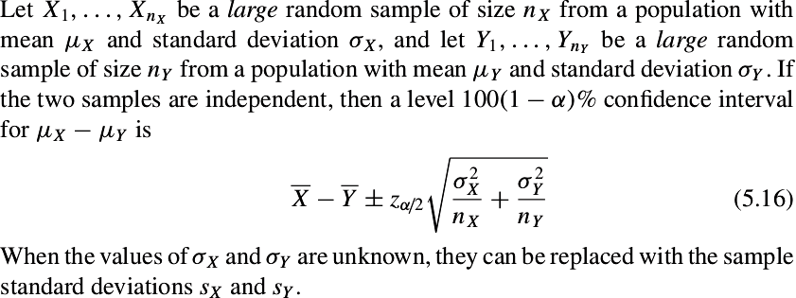
A Confidence Interval for the Difference Between Two Means

Slide 90
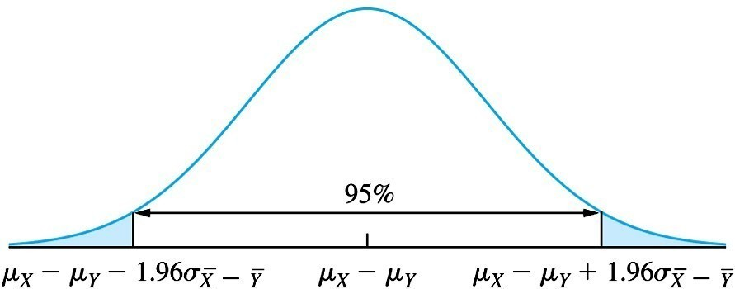
A Confidence Interval for the Difference Between Two Means

Slide 91
Problem 1
A group of 75 people enrolled in a weight loss program that involved adhering to a special diet and to a daily exercise program. After 6 months, their mean weight loss was 25 pounds, with a sample standard deviation of 9 pounds.
A second group of 43 people went on the diet but didn't exercise. After 6 months, their mean weight loss was 14 pounds, with a sample standard deviation of 7 pounds.
Find a 95% confidence interval for the mean difference between the weight losses.

Slide 92
Problem 1 : Solution
X_bar ~ N(25, 9/sqrt(75))
Y_bar ~ N(14, 7/sqrt(43))
since both the samples are independent,
a 95% Confidence Interval for μ_{X} - μ_{Y} is given by
(X_bar – Y_bar) ± z_{a/2} * sqrt( (σ_{X} ²/n₁ ) + (σ_{Y} ²/n₂) )
= (25 – 14) ± 1.96 * sqrt ( (92/75) + (72/43))
= 11 ± 1.96 * sqrt ( 2.2195)
= 11 ± 2.92
= (8.08, 13.92)

Slide 93
Construction of Confidence Intervals for Paired Data

Slide 94
Paired data
The data is described as paired when it arises from the same observational unit An example of paired data would be a before-after drug test.
The data is described as unpaired or independent when the sets of data arise from separate observational unit. For example one clinical trial might involve measuring the blood pressure from one group of patients who were given a medicine and the blood pressure from another group not given it.

Slide 95
Constructing Confidence Intervals with Paired data:
For large samples,
If the population of differences is approximately normal, then a (1 – α) 100% Confidence Interval for μ_{D} is given by
D ± z_{α / 2}σ _{D} .
In practice, σ _{D} is approximated with s_{D} / n .
For small samples (n < 30),
If the population of differences is approximately normal, then a (1 –
α) 100% Confidence Interval for μ_{D}
is given by
s_{D .}
D ± t
n−1,α / 2
n

Slide 96
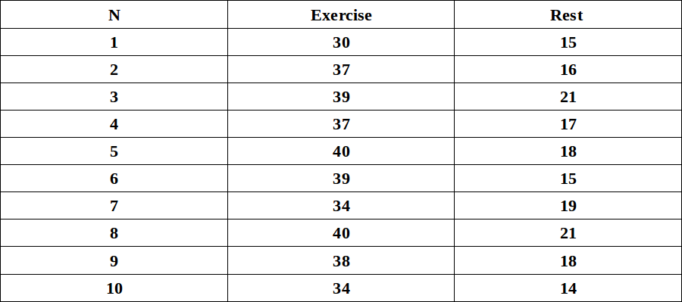
Breathing rates, in breaths per minute were measured for a group of 10 people at rest and then during moderate exercise. The results are as follows:
Find a 95% confidence interval for the increase in breathing rate due to exercise.

Slide 97
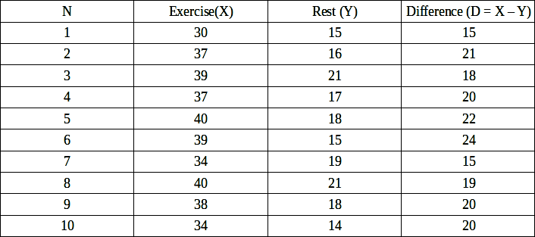
Solution
D_bar = mean of differences = 19.4
sD = standard deviation of differences = 2.836273 n = 10 , alpha = 0.05
t10−1,.025 = 2.262
The 95% confidence interval is 19.4 ± 2.262(2.836273/ √10), or (17.3712, 21.4288).

Slide 98
Construction of Confidence Intervals for Proportions of Large Samples

Slide 99
Confidence Intervals for Proportions of Large samples
The method that we discussed in the last section was for a mean from any population from which a large sample has been drawn.
When the population has a Bernoulli distribution, this expression takes on a special form.

Slide 100
Sampling Distribution of p_hat
If X ~ Bin(n , p) where n is large. Then,
Estimate of p , p_hat has the following distribution (as follows from CLT since n is large)
p_hat ~ N( p, p(1-p)/n )
It is then also true that for 95% of all possible samples,
pˆ −1.96 ^{p(1− p)} < p < pˆ +1.96
n
p(1− p)
n

Slide 101
The Traditional Method – Constructing CI for proportions
Let p_hat be the proportion of successes in a large number of independent Bernoulli trials with success probability p.
Then the traditional level 100(1 − α)% confidence interval for
p is
pˆ(1 − pˆ) .
pˆ ± z
α / 2
n
The method cannot be used unless the sample contains at least 10 successes and 10 failures.

Slide 102
Constructing CI for proportions
X ~ Bin(n, p) [n is large]. (CI : estimate ±Margin of error)
Then a 100(1 − α)% confidence interval for p is
~p(1 − ~p) .
~p ± z
_{n}~
α / 2
Where,
_{~p =} X + 2
_{n}~
&
n~ = n + 4
If the lower limit is less than 0, replace it with 0.
If the upper limit is greater than 1, replace it with 1.

Slide 103
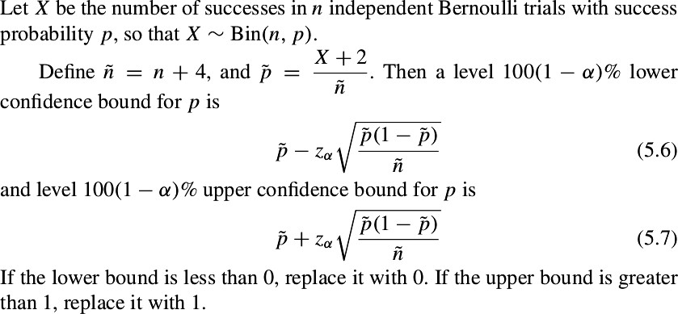
One-sided CI for proportions

Slide 104
Problem 1 – Part a
In a sample of 70 automobiles registered in a certain state, 28 of them were found to have emission levels that exceed a state standard.
1) What proportion of the automobiles in the sample had emission levels that exceed the standard?

Slide 105
Solution : Problem 1 – Part a
In a sample of 70 automobiles registered in a certain state, 28 of them were found to have emission levels that exceed a state standard.
1) What proportion of the automobiles in the sample had emission levels that exceed the standard?
X = 28 , n =70 => p_hat = 28/70 = 0.4

Slide 106
Problem 1 – Part b
In a sample of 70 automobiles registered in a certain state, 28 of them were found to have emission levels that exceed a state standard.
2) Find 95% CI for the proportion of automobiles in the state whose emission levels exceed the standard.

Slide 107
Solution : Problem 1 – Part b
2) Find 95% CI for the proportion of automobiles in the state whose emission levels exceed the standard.
X_tilde = X + 2 = 28 + 2 = 30
n_tilde = n + 4 = 70 + 4 = 74
p_tilde = X_tilde / n_tilde = 30 / 74 = 0.405
95% CI for p:
= 0.405 ± 1.96 * sqrt ( 0.405 (1 – 0.405) / 74)
= 0.405 ± 0.1118
= (0.2932 , 0.5168)

Slide 108
Problem 1 – Part c
In a sample of 70 automobiles registered in a certain state, 28 of them were found to have emission levels that exceed a state standard.
3) Find 98% CI for the proportion of automobiles in the state whose emission levels exceed the standard.

Slide 109
Solution : Problem 1 – Part c
3) Find 98% CI for the proportion of automobiles in the state whose emission levels exceed the standard.
X_tilde = X + 2 = 28 + 2 = 30
n_tilde = n + 4 = 70 + 4 = 74
p_tilde = X_tilde / n_tilde = 30 / 74 = 0.405
98% CI for p:
= 0.405 ± 2.33 * sqrt ( 0.405 (1 – 0.405) / 74)
= 0.405 ± 0.1330
= (0.272 , 0.538)

Slide 110
Problem 1 – Part d
In a sample of 70 automobiles registered in a certain state, 28 of them were found to have emission levels that exceed a state standard.
4) How many automobiles must be sampled to specify the proportion that exceed the standard to within 0.10 with 95% confidence?

Slide 111
Solution : Problem 1 – Part d
4) How many automobiles must be sampled to specify the proportion that exceed the standard to within 0.10 with 95% confidence?
95% CI is given as:
0.405 ± 1.96 * sqrt ( 0.405 (1 – 0.405) / n + 4)
=> 1.96 * sqrt ( 0.405 (1 – 0.405) / n + 4) = 0.10
=> n = 88.58 => n= 89

Slide 112
Problem 1 – Part e
In a sample of 70 automobiles registered in a certain state, 28 of them were found to have emission levels that exceed a state standard.
5) How many automobiles must be sampled to specify the proportion that exceed the standard to within 0.10 with 98% confidence?

Slide 113
Solution : Problem 1 – Part e
5) How many automobiles must be sampled to specify the proportion that exceed the standard to within 0.10 with 98% confidence?
98% CI for p:
0.405 ± 2.33 * sqrt ( 0.405 (1 – 0.405) / n + 4)
=> 2.33 * sqrt ( 0.405 (1 – 0.405) / n + 4) = 0.10
=> n = 126.82 => n = 127

Slide 114
Problem 1 – Part f
In a sample of 70 automobiles registered in a certain state, 28 of them were found to have emission levels that exceed a state standard.
6) Find 95% lower confidence bound for the proportion of automobiles whose emissions exceed the standard.

Slide 115
Solution : Problem 1 – Part f
6) Find 95% lower confidence bound for the proportion of automobiles whose emissions exceed the standard.
95% lower confidence bound for p:
0.405 – 1.645 * sqrt ( 0.405 (1 – 0.405) / 74)
= 0.3111

Slide 116
Problem 1 – Part g
In a sample of 70 automobiles registered in a certain state, 28 of them were found to have emission levels that exceed a state standard.
7) Someone claims that less than half of the automobiles in the state exceed the standard. With what level of confidence can this statement be made?

Slide 117
Solution : Problem 1 – Part g
7) Someone claims that less than half of the automobiles in the state exceed the standard. With what level of confidence can this statement be made?
=> The upper confidence bound = 0.5
=> 0.405 + z * sqrt ( 0.405 (1 – 0.405) / 74) = 0.5
=> z * sqrt ( 0.405 (1 – 0.405) / 74) = 0.095
=> z = 1.66
=> P( Z < 1.66 ) = 0.9515
Hence the level is 95.15%.

Slide 118
Problem 2
Leakage from underground fuel tanks has been a source of water pollution. In a random sample of 87 gasoline stations, 13 were found to have at least one leaking underground tank.
Find a 95% confidence interval for the proportion of gasoline stations with at least one leaking underground tank.
How many stations must be sampled so that a 95% confidence interval specifies the proportion to within ±0.03?

Slide 119
Problem 2 : Solution
X = 13, n = 87,
p = (13 + 2)/(87 + 4) = 0.16484, z _{.025} = 1.96.
The confidence interval is 0.16484 ±
1.96 * sqrt( 0.16484(1 − 0.16484)/(87 + 4))
(0.0886, 0.241).
●
●
●
●

Slide 120
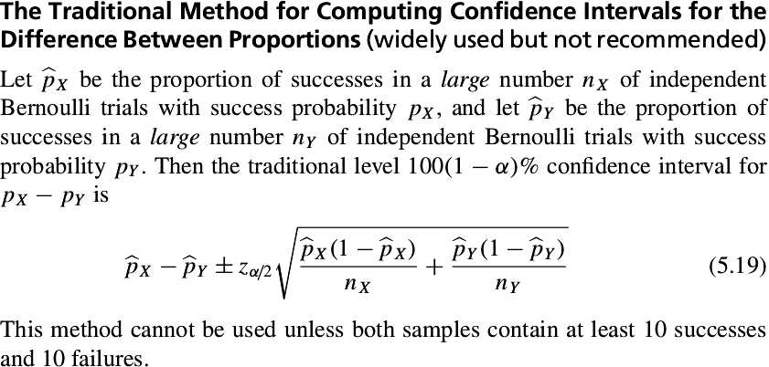
Traditional Method

Slide 121
Problem 1 : Solution
X = 20, n = 100,
X
=> p = (20 + 1)/(100 + 2) = 0.205882
X
Y = 10, n = 150,
Y
=> p = (10 + 1)/(150 + 2) = 0.072368
Y
z .05 = 1.645.

Slide 122
Problem 2(b) : Solution
If 1000 additional patients are treated with bare metal stents(earlier it was 5320), the standard deviation of the difference between the proportions is then :
= 0.01074.
=> The width of the 98% confidence interval will be ± 2.33(0.01074) = 0.0250.

Slide 123
Practice Questions

Slide 124
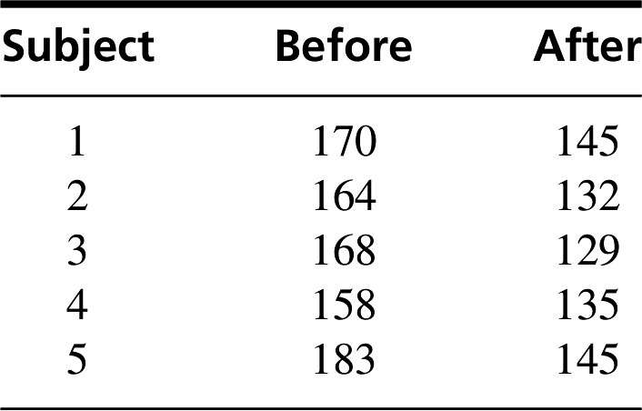
Problem 1
A group of five individuals with high blood pressure were given a new drug that was designed to lower blood pressure. Systolic blood pressure was measured before and after treatment for each individual, with the following results:
Find a 90% confidence for the mean reduction in systolic blood pressure.

Slide 125
Problem 2
●
A group of 50 computer science students were taught introductory computer programming class with an innovative teaching method that used a graphical interface and drag-and- drop methods of creating computer programs. At the end of the class, 43 of these students said that they felt confident in their ability to write computer programs.
Another group of 40 students were taught the same material using a standard method. At the end of class, 25 of these students said they felt confident.
Assume that each class contained a simple random sample of students. Find a 99% confidence interval for the difference between the proportions of students who felt confident.
●
●

Slide 126
Problem 3
A pollster plans to survey a random sample of voters in a certain city to ask whether they support an increase in property taxes to fund the construction of a new elementary school.
How many voters should be sampled to be sure that a 95% confidence interval for the proportion who favor the proposal specifies that proportion to within ±0.04?

Slide 127
Problem 4
In a study of the lifetimes of electronic components, a random sample of 400 components are tested until they fail to function. The sample mean lifetime was 370 hours and the standard deviation was 650 hours. True or false:
An approximate 95% confidence interval for the mean lifetime of this type of component is from 306.3 to 433.7 hours.
About 95% of the sample components had lifetimes between 306.3 and 433.7 hours.
The z table can’t be used to construct confidence intervals here, because the lifetimes of the components don’t follow the normal curve.

